Slide 1




Automatically Reasoning About How Systems Code Uses the CPU Cache
Rishabh Iyer
Katerina Argyraki
George Candea
Notes:
Thanks for the introduction. Today, I’m going to tell you about some of the work we’ve been doing at EPFL to help system developers better understand the performance of their code *before* it is deployed. This is joint work with my advisors, Katerina and George, at EPFL.

Slide 2
Problem Statement
Help developers answer
Frequently-asked, what-if questions about expected performance
Particularly for unseen and untested workloads
Notes:
So first and foremost, let me clarify what I mean when I say “better understand performance”? By this phrase, I am referring to helping developers answer frequently-asked, what-if questions about the expected performance of their code, particularly for previously unseen and untested workloads that it might face in production.

Slide 3
Problem Statement
Help developers answer
Frequently-asked, what-if questions about expected performance
Particularly for unseen and untested workloads
Focus on questions re: how code interacts with HW, specifically CPU caches
E.g., How does the code’s cache usage scale with workload?
E.g., What is my code’s cache hit/miss profile?
Data movement through the cache hierarchy plays a critical role in the performance of systems code
Notes:
Now, developers ask themselves many performance-related questions, but in this talk, I am going to focus on questions related to how the software interacts with the underlying hardware, specifically the CPU caches.
The reason we focus on the CPU caches because, given the ever-widening gap between processor and memory speeds, how the software interacts with the cache hierarchy often critically impacts performance, particularly for low-level systems code such as OS kernels, hypervisors, and network stacks.
To give you a concrete example of the questions we’re trying to answer.

Slide 4


Motivating Example
Alice wants to build a fast, in-memory key-value store
Hash table + network stack (off-the-shelf)
Throughput bottlenecked by L3 cache misses
Alice needs to answer questions such as
What workloads lead to consistent cache misses?
How much of the cache does each component use?
Notes:
Consider a developer Alice who is building a fast in-memory key-value store that consists of two components: a hash table that Alice wrote herself and a TCP stack she is using off-the-shelf.
Now given that, in such a system, throughput is often bottlenecked by the number of last-level cache (LLC) misses per request, Alice needs to first know what workloads can lead to consistent LLC misses and then, to optimize her code, needs to know how the different components of her system use the cache. So, for instance, how many cache lines does the hashtable code touch per key-value pair? And how many cache lines does the TCP stack’s touch per connection?

Slide 5
Existing Tools are Insufficient!
Developers rely on profilers and HW counters today
No predictive capability, insights limited to the concrete inputs used
Developers must manually reverse engineer answers to key questions
Tedious and error-prone, particularly for third-party code
Recent patch showed how Linux’s TCP stack had been incurring a bloated cache footprint for over a decade, leading to slowdowns of up to 45%
Notes:
Unfortunately, answering these questions today, using tools such as profilers and simulators is HARD, and this is because these tools only provide insights for the concrete workloads with which the code is profiled or simulated, but not about abstract, unseen workloads, which are the ones that developers want visibility into in the first place.
As a result, developers are forced to manually extrapolate and guess the answers to their key questions. This process is not only time-consuming but also error-prone, particularly for code that the developers did not write themselves (i.e., the network stack in Alice’s case).
To give you an example of just how hard these questions are to answer, a recent patch showed that the fast path of the Linux TCP stack, which is probably some of the most widely exercised code in the world, had been accessing 50 % more cache lines than it needed to for over a decade, leading to slowdowns of up to 45 %.
So clearly, developers like Alice need better tools, and if we take a step back,

Slide 6
A Lack Of Abstraction For Performance
Alice needs visibility into how the code processes an abstract/symbolic workload
Only way to obtain this information today is to read/profile the implementation
Can there exist an abstract/symbolic representation that helps developers efficiently reason about cache usage?
Notes:
we observe that the status quo is the result of a lack of abstractions for performance behavior.
More specifically, Alices needs visibility into what the code does to the cache as a function of the workload, i.e., how the code processes an *abstract or symbolic* workload.
Unfortunately, the only way for developers to obtain this information today is directly from the implementation itself, either by painstakingly reading it, which becomes infeasible after a point, or by profiling it with concrete inputs which provides incomplete information at best.
And so, in this work, we ask the question: can there exist an abstract or symbolic representation of the code that helps developers reason efficiently about cache usage without having to read the code or run elaborate benchmarks?

Slide 7


Memory Distillates
Representation that retains all information relevant to how the code accesses memory
Discards everything else
Given the same inputs as the code, the distillate
Produces an identical trace of memory accesses
But does not produce correct outputs
Code
Memory Trace
Functional Outputs
Input
Distillate
Memory Trace
Functional Outputs
Notes:
In answer to this question, we propose the notion of memory distillate, an abstraction of the code that only captures all information relevant to how the code accesses memory and discards everything else. So, when given the same inputs as the code, it will produce an identical trace of memory accesses but will not produce the correct funoutputs because functionality is one of the things it abstracts away. [Be slow here, let it sink in]
- Highlight why distillates being simple is useful

Slide 8

Cache Footprint AnalyzeR (CFAR)
Answers questions about cache usage using two-step workflow
Distillation: Extracts distillate using automated program analysis
Projection: Devs query distillate to answer specific questions
Since distillate is precise, CFAR can answer diverse questions about cache usage
Code
Distillate
Distillation
Projection
1
2
Notes:
We use the abstraction of memory distillates to build CFAR, a tool that helps developers efficiently answer diverse questions about the cache usage of both their own, as well as third-party code.
CFAR relies on a two-step workflow:
In the first step, “distillation”, CFAR extracts the distillate from the code, and in the second step “projection”, developers can query the distillate to answer specific performance questions.
The primary benefit of this two step workflow is that it enables developers to always write their own projectors and because the PER is a precise representation of performance, they will be able to obtain answers to their specific questions.
I will describe CFAR in greater detail in the rest of this talk, but if there is *one* thing I want you to take away from this talk

Slide 9
Memory distillates provide a simple yet precise abstraction for reasoning about cache usage
Notes:
, it is that memory distillates provide a simple yet precise abstraction for reasoning about cache usage. They are precise because they capture all information relevant how the code accesses memory, and they are simpler than the code itself because they abstract away everything else.

Slide 10
CFAR Overview
Distillation
Projection
Answer₁
Program
Source
Distillate
Answer₂
…
Notes:
Here is an overview of CFAR, and its three key components: the distillate, and the two stages of distillation and projection. I will now explain each of these three components, but before I do so, I want to

Slide 11
CFAR Limitations & Assumptions
Automated program analysis (symbolic execution) for distillation
Ill-suited for multi-threaded code, loops without statically-computable bounds
CFAR only extracts partial distillates in such cases
Cannot reason about speculative memory accesses
Hidden by underlying hardware
Assumes program is not preempted during execution
Reasoning about all possible concurrent programs is infeasible
Notes:
Touch upon CFAR’s limitations and assumptions to clarify its scope. First, CFAR relies on automated program analysis (specifically symbolic execution) to extract distillates.

Slide 12
CFAR Overview
Distillation
Projection
Answer₁
Program
Source
Distillate
Answer₂
…
Notes:
Here is an overview of CFAR, and its three key components: the distillate, and the two stages of distillation and projection. I will now explain each of these three components, but before I do so, I want to

Slide 13
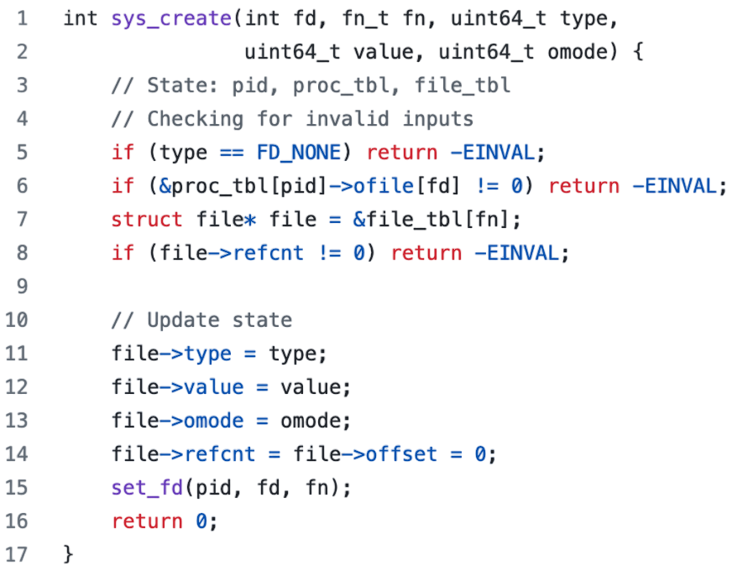
Example Syscall
sys_create() from Hyperkernel
Notes:
To do so, I will use as a running example, the create syscall from the Hyperkernel, a simple research kernel.
The create syscall is responsible for creating a new file and accesses kernel state maintained in the process table and open file table, both of which are implemented using arrays in the Hyperkernel.
The syscall first checks for invalid inputs, before updating the necessary kernel state.
While simpler than production kernels such as Linux, the syscall has a similar input-dependent access pattern: for example, it indexes the open filetable on line 7 to access the metadata corresponding to the file number, and also accesses the file descriptor table in the process control block on lines 6 and 15.
Call it the

Slide 14
Example Syscall
sys_create() from Hyperkernel
Kernel state: proc_table, filetable
Implemented as arrays
Input-dependent access pattern
Notes:
To do so, I will use as a running example, the sys_create syscall from the Hyperkernel, a simple research kernel.
The sys_create syscall is responsible for creating a new file and accesses kernel state maintained in the process table and open file table, both of which are implemented using arrays in the Hyperkernel.
The syscall first checks for invalid inputs, before updating the necessary kernel state.
While simpler than production kernels such as Linux, the syscall has a similar input-dependent access pattern: for example, it indexes the open filetable on line 7 to access the metadata corresponding to the file number, and also accesses the file descriptor table in the process control block on lines 6 and 15.

Slide 15
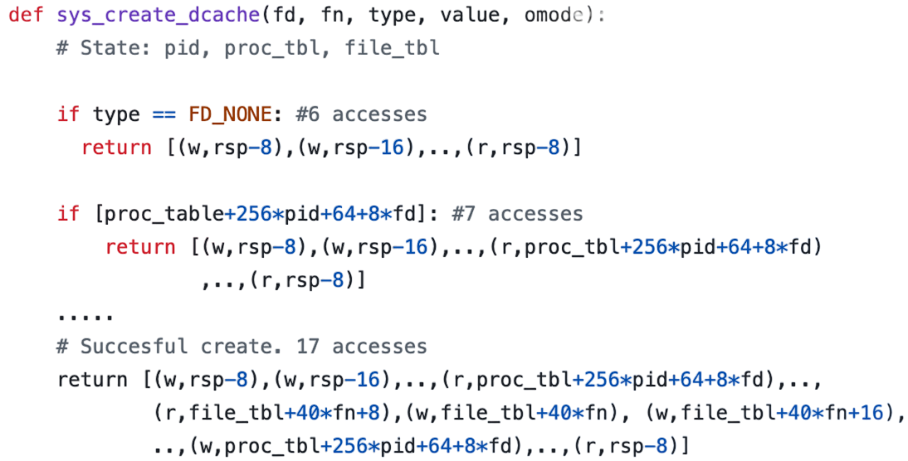
CFAR Distillate: Data Cache
Notes:
On this slide you see the CFAR distillate for data memory accesses. CFAR extracts a similar distillate for instruction memory, but I will not have time to describe it in this talk.
Before you try to read the distillate, I want to re-emphasize that this serves as an intermediate representation, and is not something that developers will have to read directly. That said, I want to highlight a few key points.

Slide 16
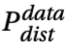
CFAR Distillate: Data Cache
The data cache distillate of a program P is a program
takes the same inputs as P (I)
and maintains the same state (S)
Notes:
Program with same inputs. Conditions expressed using inputs and state variables only.
Returns ordered sequence of memory accesses.
Explain each access.

Slide 17
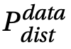
CFAR Distillate: Data Cache
returns an ordered sequence of data memory accesses Ω_{data}
Each memory access is a tuple
<type,addr>
Notes:
The key difference lies in what the distillate returns. Instead of computing the functional outputs, the distillate returns ordered sequence of memory accesses.
Each memory access in the sequence is a tuple with a type and an address.

Slide 18
CFAR Distillate: Data Cache
type can be read (r) or write (w). addr is a symbolic function of I,S
Symbolic representation enables distillate to replicate P’s memory accesses irrespective of the concrete values of input/state and address space randomization
Notes:
The type can be either a read or a write.
The address is a symbolic expression in terms of the input I and the state S.
The reason we chose such a symbolic

Slide 19
CFAR Overview
Distillation
Projection
Answer₁
Program
Source
Distillate
Answer₂
…
Notes:
Here is an overview of CFAR, and its three key components: the distillate, and the two stages of distillation and projection. I will now explain each of these three components, but before I do so, I want to

Slide 20
Extracting CFAR’s Distillates
Distillation
Program
Source
Distillate

Slide 21
CFAR Distillation: Step 1
Distillation
path constraints,
symbolic addresses
Program
Source
Symbolic Execution
Distillate
1
concrete inputs
Symbolically execute source to enumerate paths, and identify symbolic addresses and concrete inputs per path
Notes:
"the path constraint"... might want to say that it's the symbolic constraints on inputs and program state that lead the program down that path

Slide 22
CFAR Distillation: Step 2
Distillation
path constraints,
symbolic addresses
Program
Source
Symbolic Execution
Distillate
1
concrete inputs
exec trace
Binary replay
Binary
2
Binary replay to obtain precise mem. access trace for each path

Slide 23
CFAR Distillation: Step 3
Distillation
path constraints,
symbolic addresses
Program
Source
Symbolic Execution
Exec. tree synthesis
Distillate
1
concrete inputs
3
exec trace
Binary replay
Binary
2
Collate execution trace and symbolic addresses per path Synthesize execution tree containing all paths using path constraints

Slide 24
CFAR Distillation: Step 4
Distillation
path constraints,
symbolic addresses
Program
Source
Symbolic Execution
Exec. tree synthesis
Code synthesis
Distillate
1
concrete inputs
3
4
exec trace
Binary replay
Binary
2
Translate execution tree into Python program for readability
Notes:
transforms into a Python program for human readability

Slide 25
CFAR Overview
Automated Program Analysis
Projection
Answer₁
Program
Source
Distillate
Answer₂
…
Distillation
Notes:
Here is an overview of CFAR, and its three key components: the distillate, and the two stages of distillation and projection. I will now explain each of these three components, but before I do so, I want to

Slide 26
CFAR: Projection
Automated Program Analysis
Projector₁
Answer₁
Program
Source
Distillate
Projector₂
Answer₂
…
…
Distillation
Projection

Slide 27
CFAR: Projectors
User-defined functions that compute different cache-usage properties
Input: Python list containing symbolic memory accesses
Output: Answer to question about cache usage
For example:
len(list) returns number of memory accesses
len(set([x//64 for x in list])) returns unique cache lines touched
Notes:
For instance, P_scale and P_crypto both comprise < 100 LOC and P_h/m’s cache model was taken largely from Gem5. S5.2.3 also shows how a mere 5 line projector helped us find a bug in the kernel-bypass stack.

Slide 28
CFAR-Provided Projectors
CFAR comes with three projectors that answer FAQs about cache usage
P_{scale}: how cache usage scales as a function of workload
P_{h/m}: cache model to study hit and miss profile
P_{crypto}: identifying secret-dependent branches, memory accesses
Notes:
For instance, P_scale and P_crypto both comprise < 100 LOC and P_h/m’s cache model was taken largely from Gem5.

Slide 29
CFAR-Provided Projectors
CFAR comes with three projectors that answer FAQs about cache usage
P_{scale}: how cache usage scales as a function of workload
P_{h/m}: cache model to study hit and miss profile
P_{crypto}: identifying secret-dependent branches, memory accesses
Projectors are easy to write
P_{scale} and P_{crypto} are both < 100 lines of Python
The cache model in P_{h/m} is largely taken from gem5
Projectors enable developers to gain visibility into their own, as well as third party code, without having to run elaborate benchmarks
Notes:
For instance, P_scale and P_crypto both comprise < 100 LOC and P_h/m’s cache model was taken largely from Gem5.

Slide 30
CFAR: Projection
Automated Program Analysis
Projector₁
Answer₁
Program
Source
Distillate
Projector₂
Answer₂
…
…
Distillation
Projection

Slide 31
CFAR: Evaluation
Programs analyzed:
Fast path of TCP ingress, egress from Linux, IX, lwIP stack
2 hash table implementations from Vigor
51 syscalls from Hyperkernel
7 algorithms from OpenSSL 3.0
Eval questions: Are CFAR-extracted distillates
Accurate?
Useful?

Slide 32
Accuracy of CFAR’s Distillate
Manually wrote test-cases that cover ~50% of paths for each program
Measured number, addresses of
Executed instructions
Executed data memory accesses
Compared to values predicted by distillate
Observed ZERO error
CFAR’s distillate is accurate and holds irrespective of concrete values of input/state and address space randomization

Slide 33
How Does Cache Usage Scale?
Used CFAR to analyze fast path of 4 TCP stacks:
Linux before (v6.5) and after (v6.8) recent patch, IX (KB), and lwIP stack
Predicted number of connections at which each would suffer consistent LLC misses

Slide 34
How Does Cache Usage Scale?
Used CFAR to analyze fast path of 4 TCP stacks:
Linux before (v6.5) and after (v6.8) recent patch, IX (KB), and lwIP stack
Predicted number of connections at which each would suffer consistent LLC misses

Slide 35
How Does Cache Usage Scale?
Used CFAR to analyze fast path of 4 TCP stacks:
Linux before (v6.5) and after (v6.8) recent patch, IX (KB), and lwIP stack
Predicted number of connections at which each would suffer consistent LLC misses
CFAR can provide developers with clarity into cache usage even for third-party code

Slide 36
Identifying Cache-Based Leakages
Inspected 7 algorithms from OpenSSL 3.0 with P_{crypto}
AES, SHA, MD5, Poly1305, Chacha, echde, RSA
Reproduced known cache-leakage vulnerability in RSA (OpenSSL 1.0)
Found a new constant-time violation in AES, latent since OpenSSL 1.1
Acknowledged by maintainers, in final stages of being merged
Since the memory distillate is precise, developers can use CFAR to analyze more than just performance properties of code

Slide 37

Cache Footprint AnalyzeR (CFAR)
Key idea: abstraction of memory distillate
Captures details relevant to how code accesses mem, discards all else
Can be projected into answers to diverse questions about cache usage
Code
Distillate
Distillation
Projection
https://dslab.epfl.ch/research/perf

Slide 38
Backup Slides
Notes:
Motivated by the enormous benefits of semantic interfaces in system building today, in this thesis, we ask (and answer) the question: Can there exist an equivalent *latency* interface for systems code?
That is, an interface that system engineers can use to reason about the expected latency behavior of a piece of code without having to delve into the implementation.

Slide 39
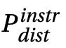
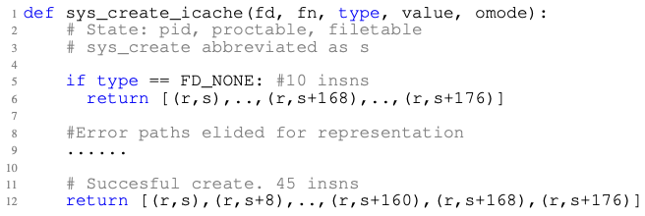
CFAR Distillate: i-cache
The i-cache distillate is a program that takes the same arguments as P and returns an ordered sequence of instr memory accesses Ω _{instr}
Notes:
Program with same inputs. Conditions expressed using inputs and state variables only.
Returns ordered sequence of memory accesses.
Explain each access.

Slide 40
CFAR Distillate: i-cache
Instr addresses are expressed as offsets relative to the memory address of the first instruction every function in P
CFAR’s i-cache distillate will produce the precise sequence of instructions executed by P irrespective of where the code is loaded
Notes:
Program with same inputs. Conditions expressed using inputs and state variables only.
Returns ordered sequence of memory accesses.
Explain each access.

Slide 41
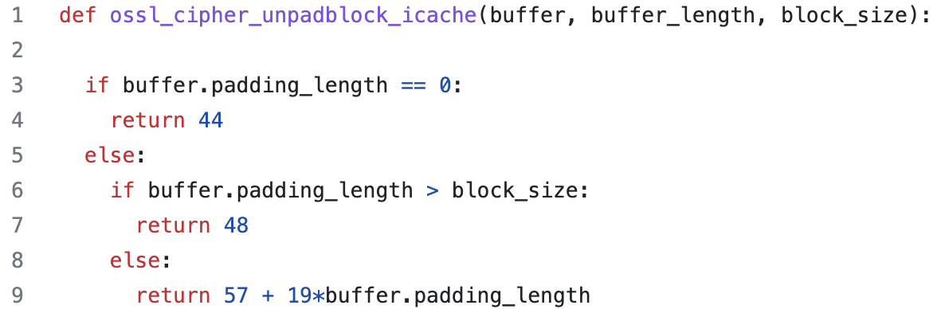
Constant-Time Violation in AES

Slide 42
Constant-Time Violation in AES
Projection showing constant-time violation

Slide 43
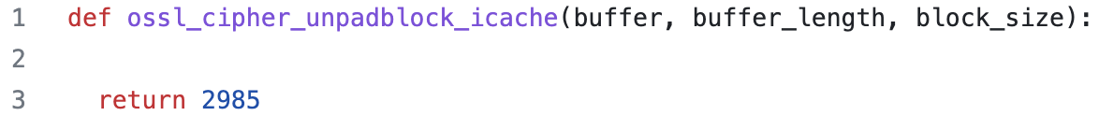
Constant-Time Violation in AES
Projection showing constant-time violation
Projection after fix

Slide 44
Loop Summarization in CFAR
Does not impact precision, only readability
Best-effort process
Uses templates for “common” loop access patterns [DMON OSDI’21]
2 array-based, 2 pointer-chasing patterns
Requirements:
Loop body does not branch on value of iteration counter
Maximum of 2 termination conditions for the loop.

Slide 45
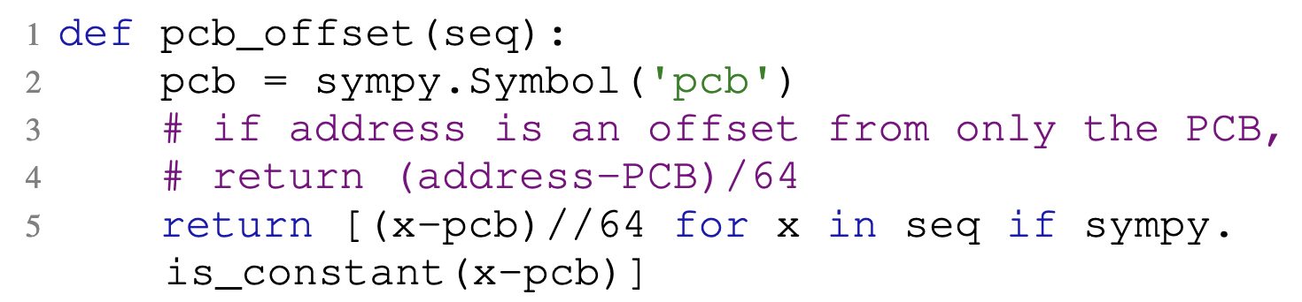
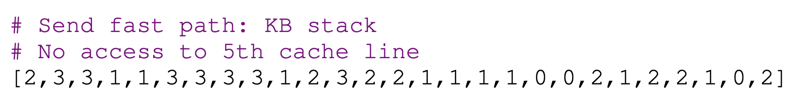
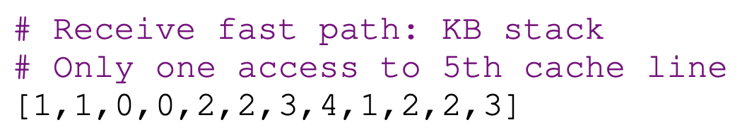
Identifying Inefficient Access Patterns
Identified a case of false sharing in the IX stack using a simple 5 line projector
Returned Python lists for send and receive fast paths
Notes:
A more extreme example of performance regressions is side channels in cryptographic code.
To avoid side channels, such code must run in “constant-time” w.r.t the program’s secrets.
Concretely this translates to no secret dependent branches, memory accesses or variable latency operations such as division.
Since a performance interface describes all causes of performance variability, it should be able to tell if performance depends on secrets.
To test this, we automatically extracted performance interfaces for 12 algorithms from OpenSSL 3.0, these include the most commonly used ones such as SHA, MD5, AES, etc
And in doing so we discovered a constant-time violation in AES that had been latent for 4 years since OpenSSL 1.1
I’m now going to show you how easy performance interfaces make identifying such violations

Slide 46
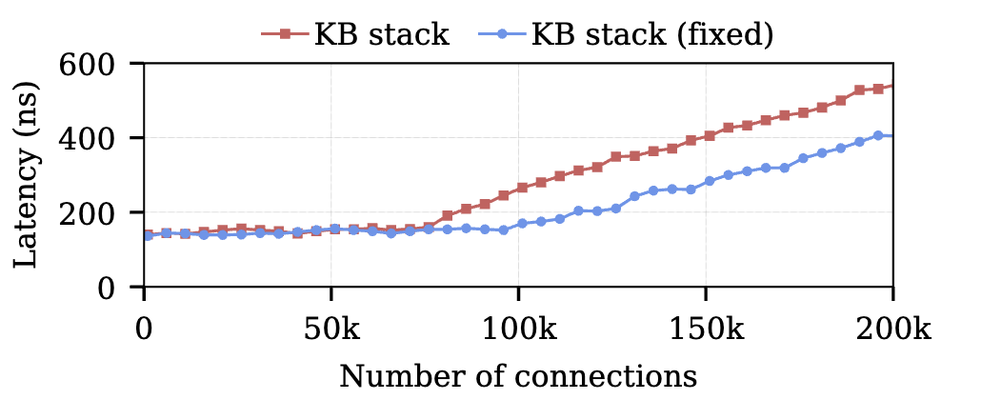
Identifying Inefficient Access Patterns
Re-organized struct tcp_pcb for cache efficiency (confirmed by projector)
CFAR enables developers to identify inefficient access patterns without elaborate benchmarking
Notes:
A more extreme example of performance regressions is side channels in cryptographic code.
To avoid side channels, such code must run in “constant-time” w.r.t the program’s secrets.
Concretely this translates to no secret dependent branches, memory accesses or variable latency operations such as division.
Since a performance interface describes all causes of performance variability, it should be able to tell if performance depends on secrets.
To test this, we automatically extracted performance interfaces for 12 algorithms from OpenSSL 3.0, these include the most commonly used ones such as SHA, MD5, AES, etc
And in doing so we discovered a constant-time violation in AES that had been latent for 4 years since OpenSSL 1.1
I’m now going to show you how easy performance interfaces make identifying such violations

Slide 47
CFAR Overview
Distillation
Projection
Answer₁
Program
Source
Distillate
Answer₂
…
Notes:
Here is an overview of CFAR, and its two stages.

Slide 48
CFAR Overview
Automated Program Analysis
Projection
Answer₁
Program
Source
Distillate
Answer₂
…
Distillation
Distillate is uniquely determined by input program
Notes:
Under the covers, CFAR is a program analysis tool, and employs automated program analysis in the first stage to automatically extract the distillate from the program source code. This distillate is uniquely determined by the input program.

Slide 49
Extracting CFAR’s Distillates
Distillation
Program
Source
Symbolic Execution
Exec. tree synthesis
Code synthesis
Distillate
1
3
4
Binary replay
2

Slide 50
CFAR Overview
Automated Program Analysis
Projector₁
Answer₁
Program
Source
Distillate
Projector₂
Answer₂
…
…
Distillation
Projection
Developers write projectors in the form of simple programs
Projectors process the distillate into the answers to developers’ questions
Notes:
In the second phase, developers can write simple programs (“projectors”) that use the distillate to compute answers to specific questions they have about the program’s cache usage. The current CFAR prototype comes with several projectors that answer frequently asked questions about cache usage. We envision developers contributing more such projectors, making CFAR more useful over time.

Slide 51
CFAR Distillation: Step 1
Distillation
path constraints,
symbolic addresses
Program
Source
Symbolic Execution
Exec. tree synthesis
Code synthesis
Distillate
1
concrete inputs
3
4
Binary replay
2
Symbolically execute source to enumerate paths, and identify symbolic addresses and concrete inputs per path
Notes:
"the path constraint"... might want to say that it's the symbolic constraints on inputs and program state that lead the program down that path

Slide 52
CFAR Distillation: Step 2
Distillation
path constraints,
symbolic addresses
Program
Source
Symbolic Execution
Exec. tree synthesis
Code synthesis
Distillate
1
concrete inputs
3
4
exec trace
Binary replay
Binary
2
Binary replay to obtain precise mem. access trace for each path

Slide 53
CFAR Distillation: Step 3
Distillation
path constraints,
symbolic addresses
Program
Source
Symbolic Execution
Exec. tree synthesis
Code synthesis
Distillate
1
concrete inputs
3
4
exec trace
Binary replay
Binary
2
Collate execution trace and symbolic addresses per path Synthesize execution tree containing all paths using path constraints

Slide 54
CFAR Distillation: Step 4
Distillation
path constraints,
symbolic addresses
Program
Source
Symbolic Execution
Exec. tree synthesis
Code synthesis
Distillate
1
concrete inputs
3
4
exec trace
Binary replay
Binary
2
Translate execution tree into Python distillate for readability
Notes:
transforms into a Python program for human readability

